Slide 1
Vaping, E-cigarettes, & Tobacco
Tonka CARES
Minnetonka Public Schools
Association for Non-Smokers Minnesota

Slide 2
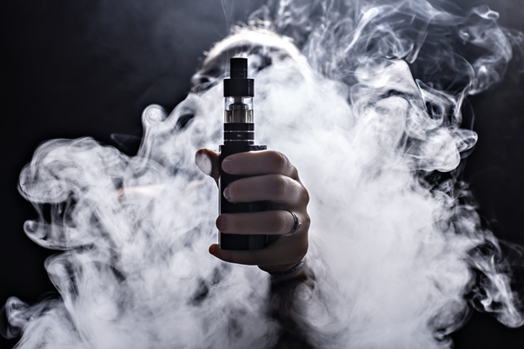
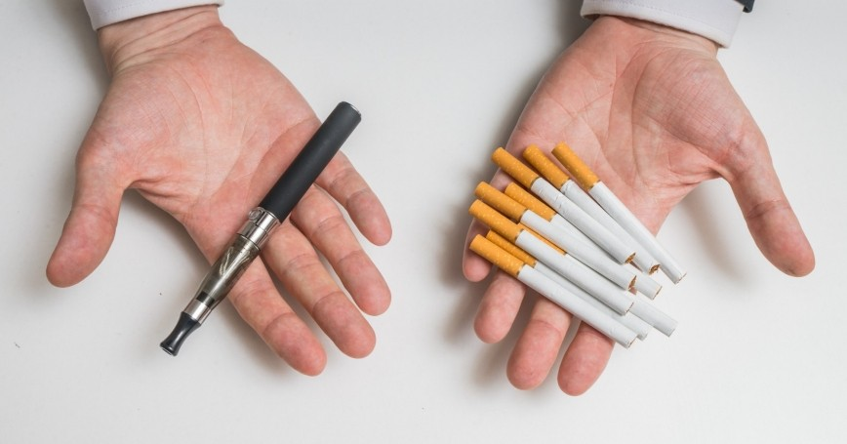
Agenda
Tonka CARES
  Introductions
  Defining vaping
  Risks/Harms
  Trends
ANSR- Association for Non-Smokers Minnesota
  History of electronic devices
  Public Health Concerns
  What’s been done AND What can we do??
Minnetonka High School Administrators
  Policies, Rules, Regulations, and Support Services
Resources
Questions

Slide 3
What is vaping….
E-cigarettes/vape devices are battery powered devices that deliver an e-liquid (often nicotine containing) aerosol to the user by vaporizing a solution to simulate a traditional cigarette. Vaping is the act of inhaling and exhaling this aerosol.
The term is used because e-cigarettes do not produce tobacco smoke, but rather an aerosol, often mistaken for water vapor, which actually consists of fine particles.
Generally a vaping device consists of a mouthpiece, a battery, a cartridge for containing the e-liquid or e-juice, and a heating component for the device that is powered by a battery.
When the device is used, the battery heats up the heating component, which turns the contents of the e-liquid into an aerosol that is inhaled & exhaled.
Notes:
Aerosol: is a suspension of particulates in a liquid or gas

Slide 4
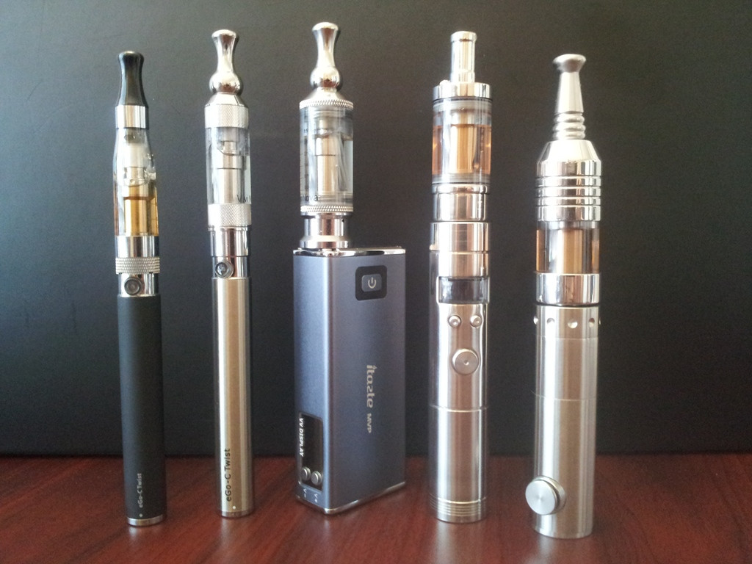
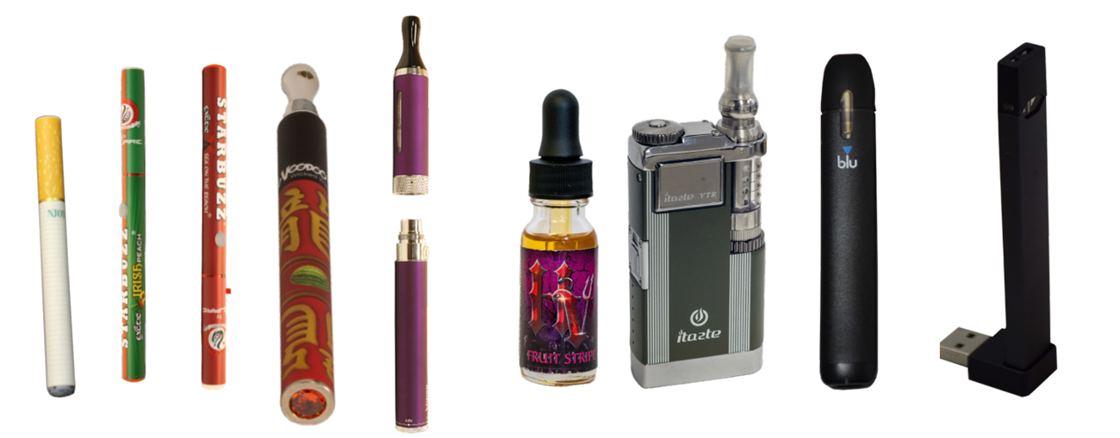
Vape Devices…

Slide 5
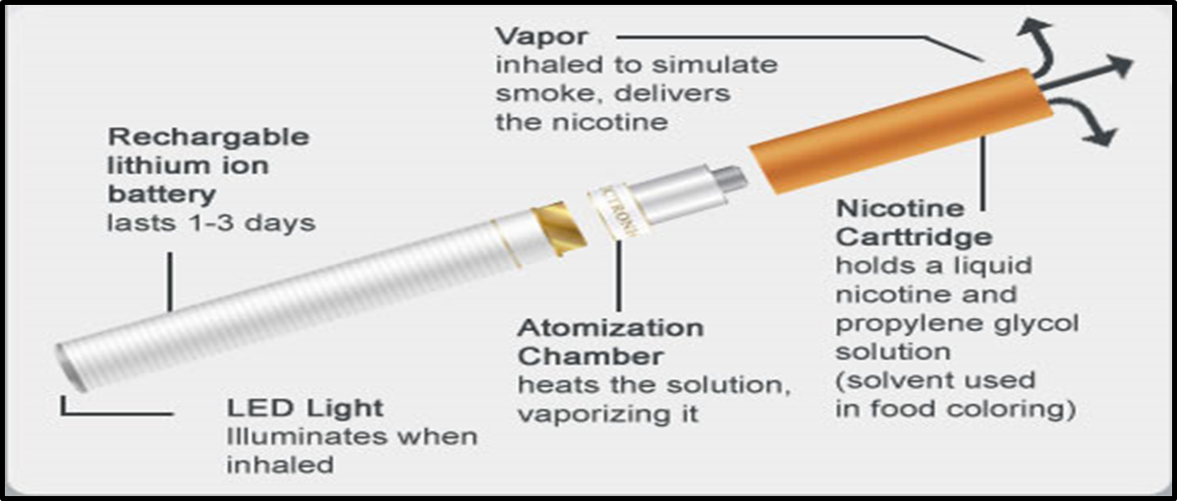
Structure of the e-cigarette

Slide 6
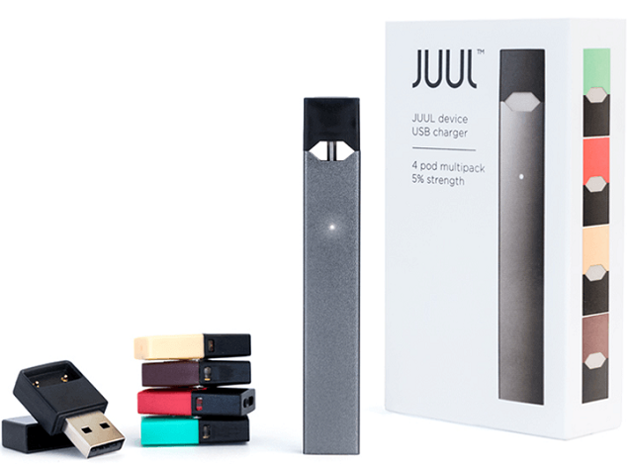
“The JUUL by Pax is unlike most vaping devices on the market. It blurs the lines between cigalikes and vape pens, with a unique, USB pen drive-like design and pre-filled cartridges that use nicotine salts to provide a much more satisfying vape. “
“The vapor production is easily in line with what you get from much bigger, more complicated devices. Finally, the high-nicotine e-liquid (50 mg/ml) used makes it satisfying for even the heaviest smokers.”
“The JUUL is available as part of a starter kit for $49.99, which comes with the device, the USB charger and four JUULpods.”
One JUUL pod is approximately equivalent to 1 pack of cigarettes or 200 puffs. Each JUULpod contains 0.7mL with 5% nicotine by weight.

Slide 7

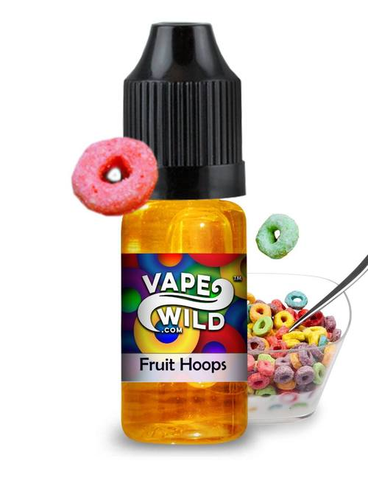
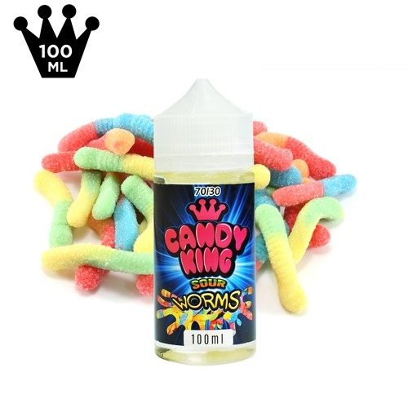
E-liquids aka Juice
The e-liquid in vaporizer products usually contains a propylene glycol or vegetable glycerin-based liquid with nicotine, flavoring and other chemicals and metals, but not tobacco.
Many of these particles contain varying amounts of toxic chemicals, including formaldehyde, acrolein, lead, tobacco-related nitrosamines and a wide variety of other substances.
Many of these chemicals have previously been found to be carcinogenic, in addition to being associated with a variety of respiratory and heart disease- related illnesses.

Slide 8
Vaping as a cessation tool???
Electronic cigarettes were originally marketed as a cessation device for long-term smokers, HOWEVER, neither the US Food and Drug Administration (FDA) nor American Medical Association has approved or recommended electronic cigarette devices as a cessation device.
  “E-cigarettes might present an effective alternative to leaf tobacco use for some smokers, but clinical testing, larger population studies, and full analyses of their ingredients and manufacturing processes need to be conducted before their safety, viability, and impacts can be determined as either clinical tools or as widely available, effective alternatives to tobacco use. Whether e-cigarettes can safely help people quit smoking also is unknown, but with their fruit and candy flavors, they have a clear potential to entice new smokers.”- American Medical Association
This sentiment is shared by the health organizations world-wide.

Slide 9

Adverse affects
  SO what are the harms of vaping….
    Neurodevelopment derangements
    Nicotine effects
    Dangers of accompanying substances in the aerosol (often referred to as vapor)
    Dangers of temperature modifications of the content (combustible components)
    Use of recreational marijuana and synthetic drugs

Slide 10
Neuro-development
Regional brain development during adolescence occurs at varying times.
Limbic structures important in emotional processing and reward-systems mature at the earlier stages of adolescence.
Contrarily, the development of the frontal and prefrontal cortical areas of the brain responsible for cognitive control over behavior mature later during adolescence and early adulthood (up to age 26).
UMMMMMM……. SO WHAT DOES THIS MEAN ???
Adolescent behaviors are largely driven by a strong emotional, reward-systems response as opposed to strong cognitive self- control and adult decision making strategies which are still developing .
Thus, compared with adults, adolescents are generally more readily motivated by rewards, less averse to risks, and more easily influenced by peers.

Slide 11
Neuro-development & Adverse effects
As a result of the maturation process the adolescent brain is also MORE SENSITVE and VULNERABLE to the rewarding effects of NICOTINE.
  Increased sensitivity means the most susceptible youth lose autonomy over tobacco intake within 1-2 days of use.
  Nicotine exposure during adolescence is associated with deleterious effects on the development of the prefrontal cortex → associations between nicotine exposure during adolescence and increased cognitive deficits and addiction later in life.
Even nicotine-free e-cigarettes should NOT be recommended to adolescents as this “renormalizes” smoking and regularizes the behavior of tobacco-product use.

Slide 12
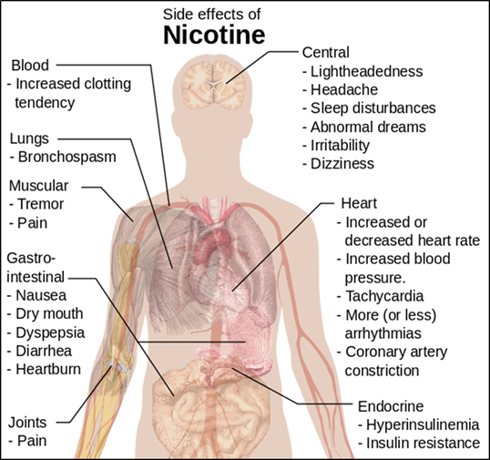
How does Nicotine affect US?

Slide 13

Popcorn Lung
Over a decade ago, workers in a microwave popcorn factory were sickened by breathing in diacetyl—the buttery-flavored chemical in foods like popcorn, caramel and dairy products. While this flavoring may be tasty, it was linked to deaths and hundreds of cases of bronchiolitis obliterans (BO), a serious and irreversible lung disease.
BO results in scarring of the tiny air sacs in the lungs resulting in the thickening and narrowing of the airways.
BO causes coughing, wheezing and shortness of breath, similar to the symptoms of chronic obstructive pulmonary disease (COPD).
Based on studies carried out by Harvard University, 39 of 51 e-cigarette brands contained diacetyl!!!!

Slide 14
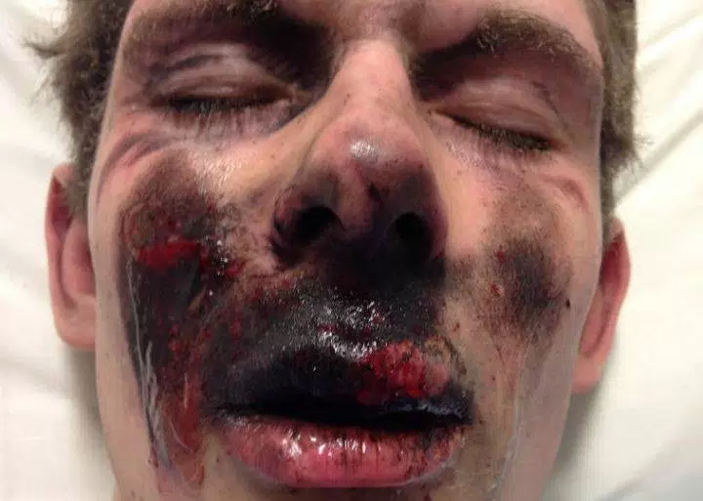
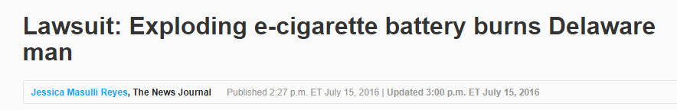
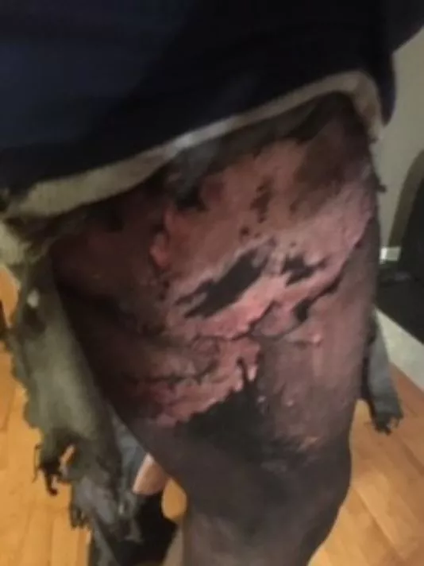
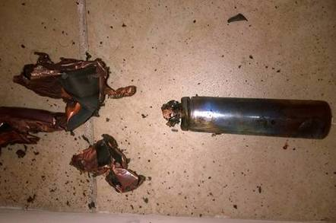
Thermal Injury
Thermal injury is predominantly attributed to its lithium-ion battery and incompatibility of heating device components.
Several types of injuries can occur, including chemical and thermal burns, inhalation injuries, metal poisoning, etc.

Slide 15
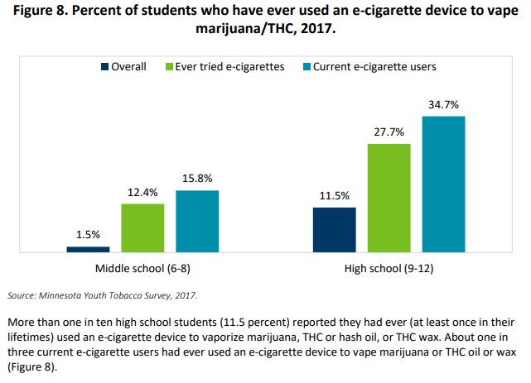
Electronic Devices & Recreational Marijuana
Electronic devices can be used to vaporize THC oil, or THC wax.
The odor is reduced and/or eliminated as compared with traditional smoking.
THC concentrations in oils and waxes can be considerably higher and thus far more potent.

Slide 16
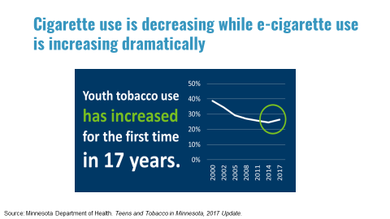
Trends & Statistics
The Minnesota Youth Tobacco Survey (MYTS) has been conducted since 2000, by the Minnesota Department of Health. For the first time since its initial administration, the Minnesota Youth Tobacco Survey reported an increase in use of tobacco products among middle school and high school students in 2017. This increase is attributable to the rising popularity of e-cigarettes and flavored products.

Slide 17
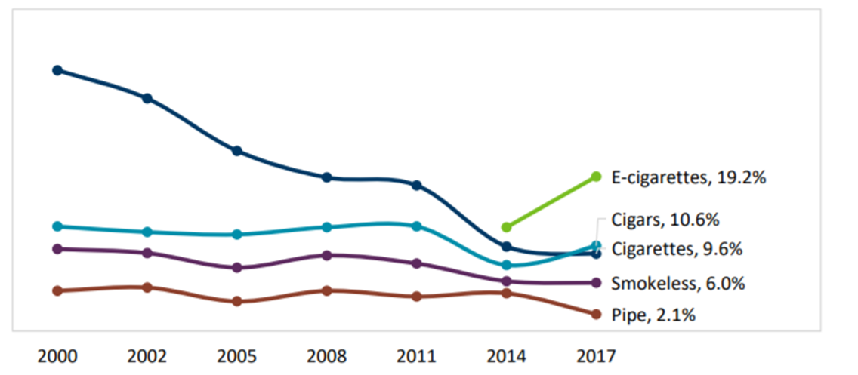
Percent of high school students who used various tobacco products in the last 30 days

Slide 18
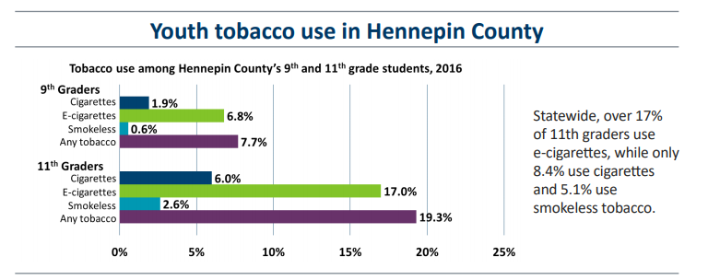
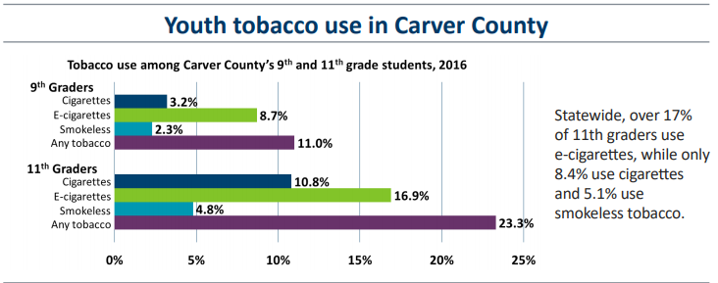

Slide 19
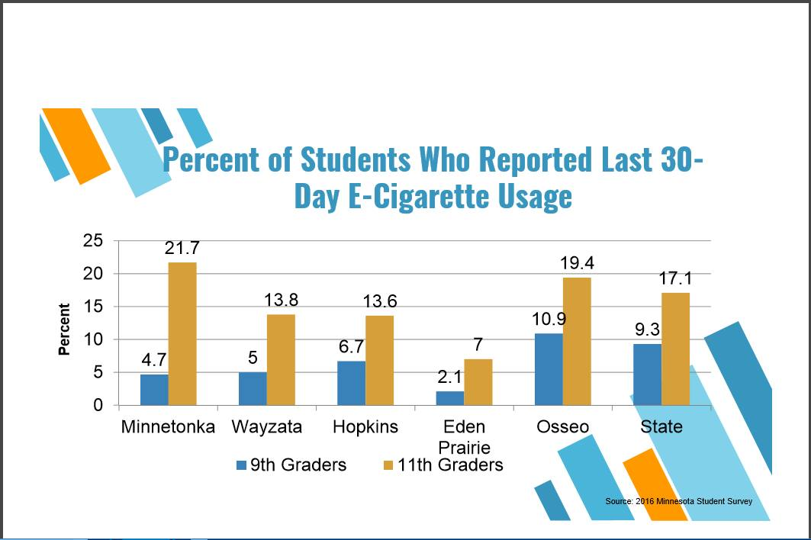
Minnesota state student survey 2016

Slide 20
So why and how is this all occurring
Kristen Ackert, MPH
Association for Nonsmokers-Minnesota
kristen@ansrmn.org
651-646-3005

Slide 21
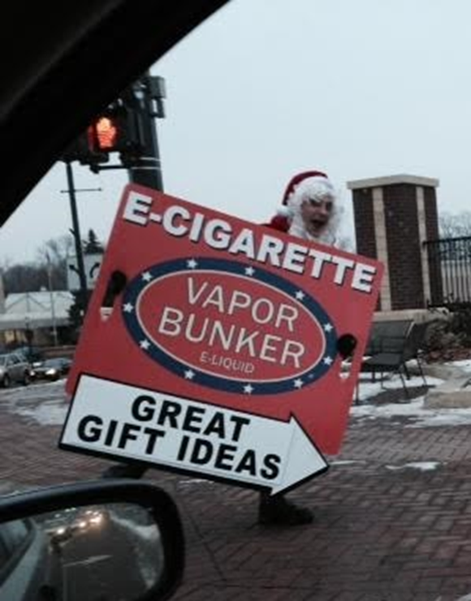
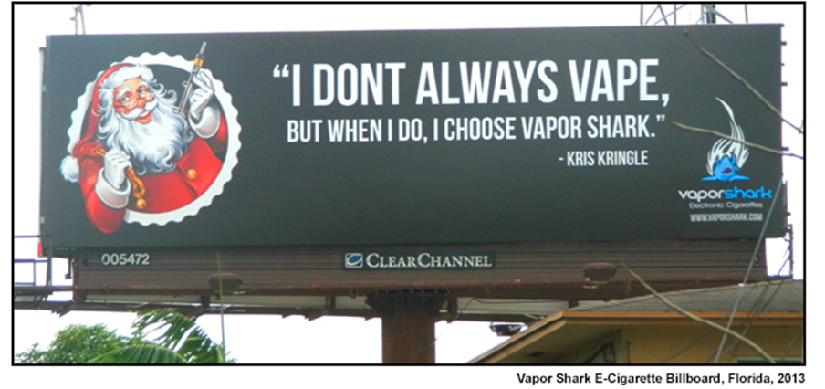
E-Cigarette Advertising
Notes:
The tobacco industry is restricted from using cartoon characters in their advertisements. The e-cigarette industry is not subject to the same restrictions and has reverted to using advertising tactics once used by the tobacco industry. The photo on the left was taken in Robbinsdale, Minnesota, with a man dressed up as Santa advertising for a e-cigarette shop. The billboard is from Florida.

Slide 22
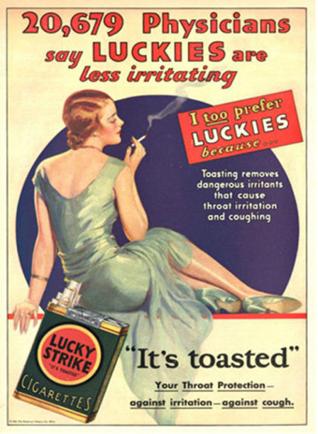
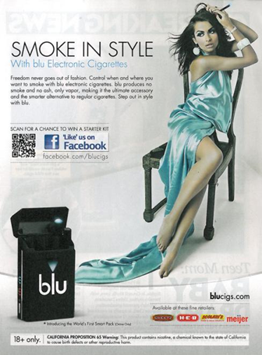
1930
2011
Notes:
This is another example of the e-cigarette industry using the same advertising tactics as the tobacco industry. These examples are from 1930 and 2011.

Slide 23
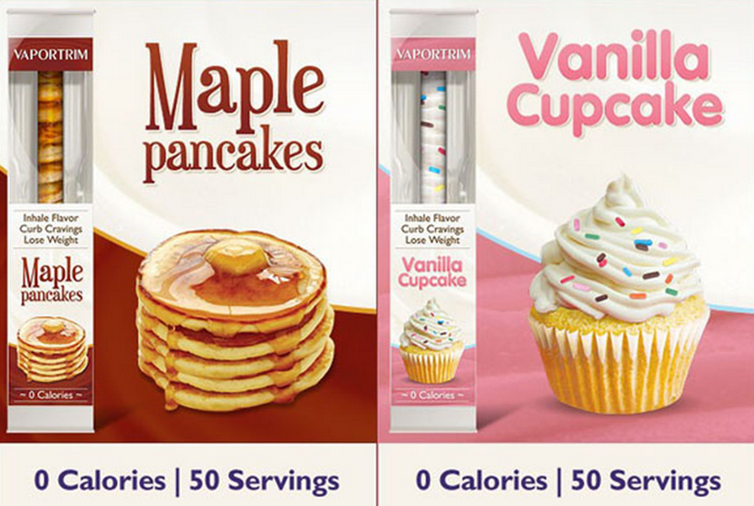
Notes:
Here is an example of two of the MANY flavored e-cigarette products available. Notice the flavors that are very appealing to young people.

Slide 24
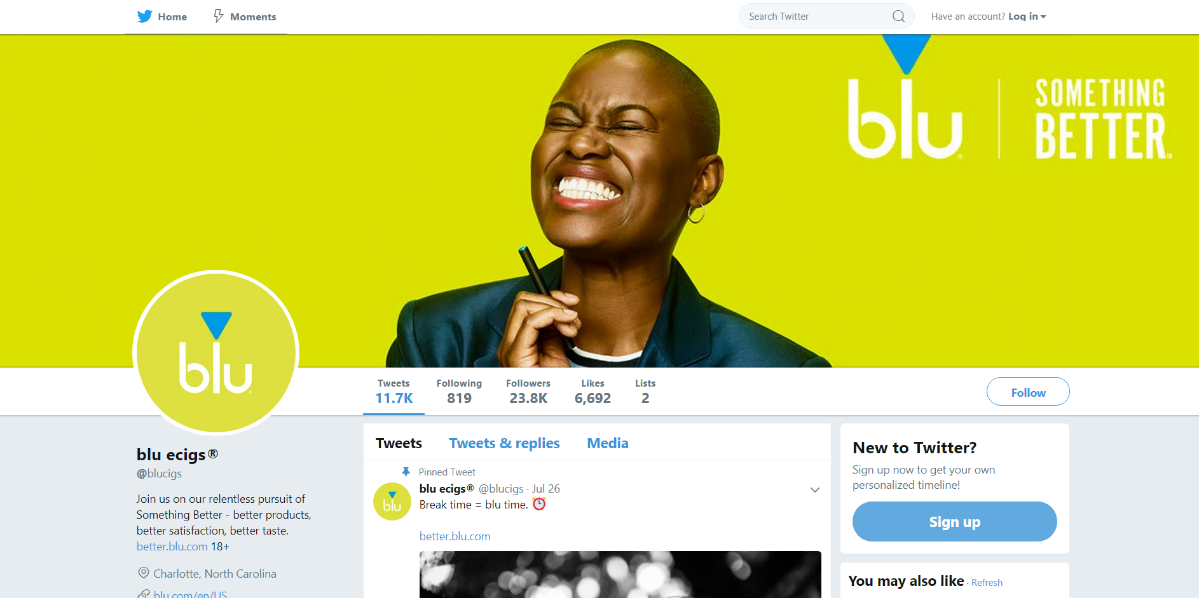
Notes:
E-cigarettes are also heavily promoted on social media platforms. Here is an example of Twitter and Youtube Blu E-cig promotions.

Slide 25
Policies that address youth tobacco use

Slide 26
Tobacco Prevention Wins in Minnesota
2007
Minnesota passed the Freedom to Breathe Act, making all worksites including bars and restaurants smoke-free
2010
Minnesota modernized the definition of tobacco products to include new products and made it illegal to sell these products to minors
2013
Minnesota increased tobacco taxes to prevent youth from starting to smoke and help people quit
2017
Notes:
Minnesota is a national leader in tobacco control. We have had many policy wins over the last ten years.

Slide 27
Some Recent Local Policy Wins in Minnesota
2014
Brooklyn Center is the first city in Minnesota to set minimum price for little cigars to $2.10
Saint Paul sets minimum cigar price to $2.10
Bloomington sets minimum price for little cigars to $2.60 and prohibits e-cigarette use in public places
2015
Richfield and Renville County set minimum price for little cigars and prohibit e-cigarette use in public places
Olmsted and St. Louis Counties prohibit e-cigarette use in public places
Minneapolis restricts fruit and candy flavored tobacco to adult-only tobacco stores & sets minimum price for cigars
2016
Saint Paul restricts fruit and candy flavored tobacco to adult-only tobacco stores & increases minimum price for cigars from $2.10 to $2.60
Murray and Morrison County set minimum price for cigars
Shoreview restricts flavored tobacco to adult-only tobacco stores
2017
Kandiyohi County prohibits e-cigarette use in public places, prohibits free sampling of cigarettes and e-cigarettes and prohibits smoking within 25 ft. of a public building
Edina, St. Louis Park, Bloomington and Edina raise the tobacco sales age to 21
Notes:
In addition to success at the state level, there have been many local policy wins over the last 10 years. Note: this is not a comprehensive list.

Slide 28
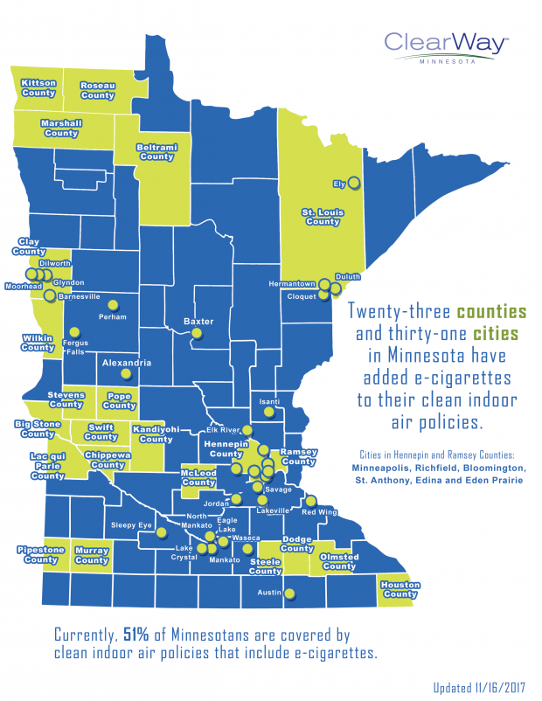
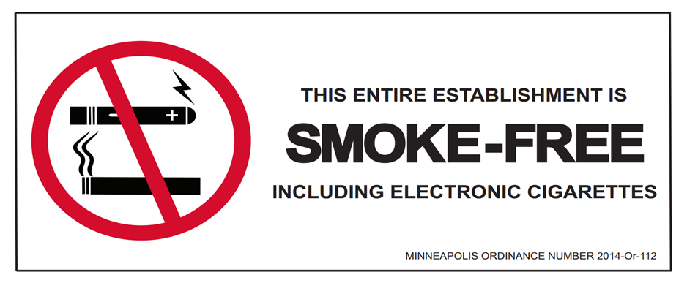
Minnesota cities and counties can prohibit the use of electronic cigarettes in all indoor public places where cigarettes and other tobacco products are already prohibited.
79% of Minnesotans favor including e-cigarettes in clean indoor air policies.
Notes:
Cities and counties throughout Minnesota have passed policies that prohibit the use of e-cigarette in indoor public spaces, such as bars and restaurants, where cigarettes and other tobacco products are already prohibited, Currently, 51% of Minnesotans are covered by these policies. 79% of Minnesotans favor including e-cigarettes in clean indoor air policies.
Many kids have grown up in a time where smoking in a restaurant was not allowed. This type of policy helps reduce visibility of these products, reduces the normalization of vaping/smoking and helps prevent exposure to the harmful chemicals that are emitted from e-cig devices.

Slide 29
Minnesota E-Cigarette Laws
Illegal to sell an e-cigarette to a minor
Illegal for minors to possess an e-cigarette
Sets a minimum penalty for stores that sell e-cigarettes to minors
Requires e-cigarettes be sold behind the counter in stores (except tobacco shops)
Prohibits the sale of e-cigarettes from a moveable place of business such as a mall kiosk, van or tent
E-cig liquid must be sold in child-resistant packaging
Prohibits the use of e-cigarettes in all government-owned or leased buildings (schools, city hall, DHS licensed facilities, etc.)
Notes:
Minnesota state law now treats e-cigarettes like it does all other tobacco products:
It is illegal for e-cigarette to be sold or possessed by a minor in the state of Minnesota
State law sets a minimum fine/penalty for stores that sell an e-cigarette (or other tobacco product) to a minor
Requires that e-cigarettes be sold behind the counter in places like a gas station or pharmacies and requires that a clerk hands the product to the purchaser, except in a tobacco shop that is only accessible to people 18 or older
E-cigs and other tobacco products cannot be sold from any moveable place of business such as a kiosk, van or tent – the purpose of this is to ensure city authorities can check to make sure anyone selling tobacco is complying with all laws
E-cigarette liquid should be sold in child resistant packaging – this is to ensure that no young children are inadvertently poisoned or harmed by liquid nicotine left unattended
E-cigarettes are prohibited in government-owned or leased buildings – it is illegal to use an e-cig in a school, city hall/city offices, DHS licenses facilities (daycares), jails/correctional facilities, or state colleges or universities

Slide 30
Tobacco 21
Notes:
Why is raising the tobacco sales age an effective way to reduce youth tobacco use?

Slide 31
“Raising the legal minimum age for cigarette purchaser to 21 could gut our key young adult market...”
-Philip Morris report, January 21, 1986
Source: Truth Tobacco Industry Document Library
Notes:
https://www.industrydocumentslibrary.ucsf.edu/tobacco/docs/#id=zswh0127

Slide 32
Youth tobacco use is still a problem
Tobacco use is the number one cause of preventable death and disease.
In Minnesota, 19% of students used tobacco in the past 30 days.
9th and 11th graders are now using e-cigarettes at twice the rate of regular cigarettes.
Flavored tobacco products are appealing to youth.
Sources:
Minnesota Department of Health. Teens and Tobacco in Minnesota. November 2014.
Minnesota Student Survey 2016.
Notes:
Citation for “19 percent of high-school students used tobacco in the past 30 days”: Minnesota Department of Health. Teens and Tobacco in Minnesota, 2014 Update - Results from the Minnesota Youth Tobacco Survey. November 2014.
Source: 2016 Minnesota Student Survey

Slide 33
95% of current adult smokers started before they were 21.
Keeping tobacco out of high schools will reduce the number of youth under 18 who become addicted to tobacco.
Source: U.S. Department of Health and Human Services. 2014
Notes:
If youth don’t start by the time they are 21, they likely never will.
Ages 18-21 are a critical time when young people move from intermittent smoking to daily use. Four out of five experimental smokers become daily smokers by age 21.
If we are serious about reducing smoking and realizing a smoke-free generation, we need to focus on preventing the start.
People don’t start smoking when they are 30 or 40. They start when they are teenagers – 13, 14, 15.
U.S. Department of Health and Human Services. Results from the 2010 National Survey on Drug Use and Health: Summary of National Findings. Substance Abuse and Mental Health Services Administration - Center for Behavioral Health Statistics and Quality; September 2014 https://www.samhsa.gov/data/sites/default/files/NSDUH-DetTabs2014/NSDUH-DetTabs2014.pdf.
Campaign for Tobacco-Free Kids. Increasing the Sale Age for Tobacco Products to 21. https://www.tobaccofreekids.org/what_we_do/state_local/sales_21

Slide 34

Human and economic cost to tobacco use:
6,312 Minnesotans die each year from tobacco use
Smoking costs Minnesota more than $7 billion annually in lost productivity and excess health care costs
Source: Blue Cross and Blue Shield of Minnesota. January 2017
Notes:
$3.19 billion in health care costs
$4.3 billion in lost productivity
Blue Cross and Blue Shield of Minnesota. Health Care Costs and Smoking in Minnesota. January 2017

Slide 35
Many youth get tobacco from older peers
59% of 18-19-year-olds have been asked to buy cigarettes for someone younger.
High school students are less likely to be around a 21-year-old than they would be an 18-20-year-old in a setting where they would ask for tobacco.
Sources:
Ribisl et. al. 1999
Ahmed, S et. al. 2005
Notes:
63 percent of 12 to 17 year-olds who smoked in the last month gave money to others to purchase cigarettes for them
Ribisl KM, Norman GJ, Howard-Pitney B, Howard KA. Which adults do underage youth ask for cigarettes? Am J Public Health. 1999;89(10):1561-1564.
Ahmad, S. (2005). Closing the youth access gap: the projected health benefits and cost savings of a national policy to raise the legal smoking age to 21 in the United States. Health Policy, 75(1), 74-84.

Slide 36
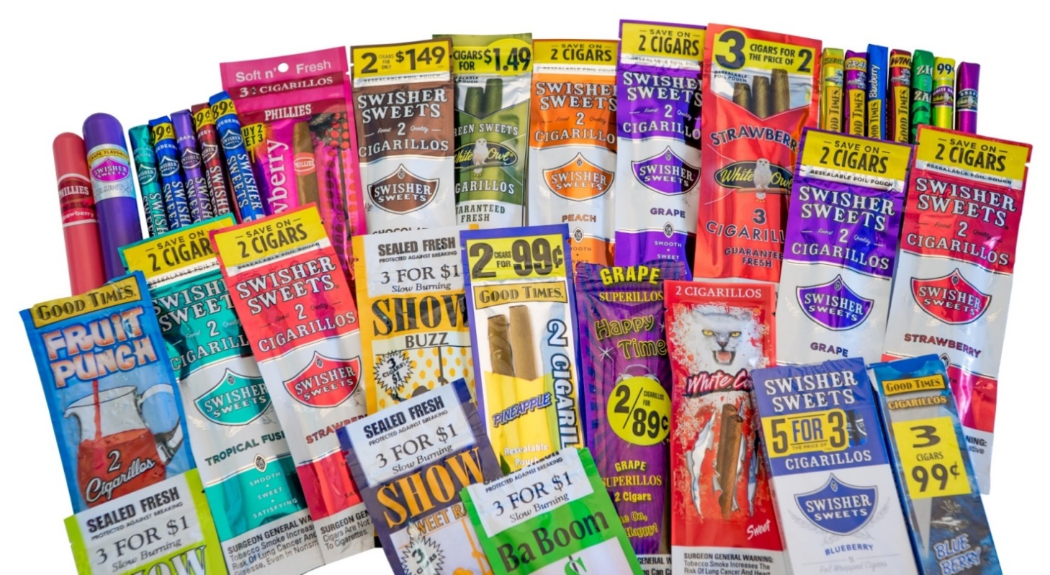
The tobacco industry targets youth
The tobacco industry spends $115.8 million on marketing each year in Minnesota.
The industry is constantly looking to replace smokers who die from diseases related to tobacco use.
Source: Campaign for Tobacco Free Kids
Notes:
The tobacco industry uses cheap prices, appealing flavors and targeted advertising to attract youth.
https://www.tobaccofreekids.org/facts_issues/toll_us/minnesota.

Slide 37
National Academy of Medicine Report- 2015
The National Academy of Medicine found that increasing the tobacco sales age to 21 would decrease smoking initiation among 15-17 year-olds by 25%.
Source: National Academy of Medicine. 2015.
Notes:
The Institute of Medicine Report supported raising the tobacco sales age and found that it would decrease the number of youth that started to smoke.
Citation: Institute of Medicine. Public Health Implications of Raising the Minimum Age of Legal Access to Tobacco Products. National Academy Press. 2015.

Slide 38
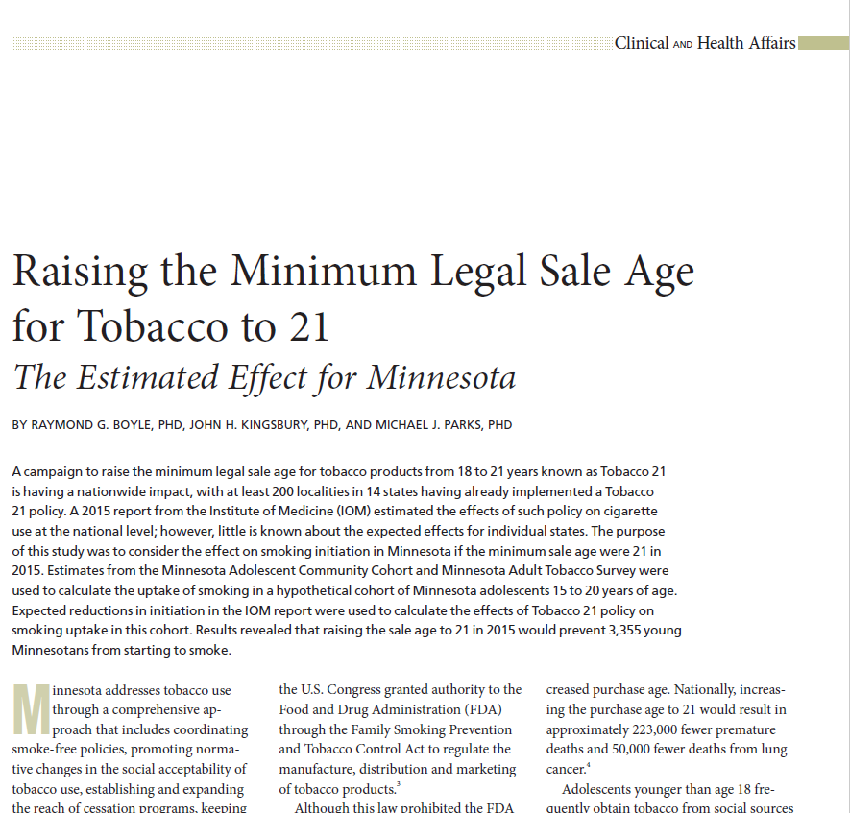
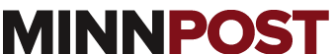
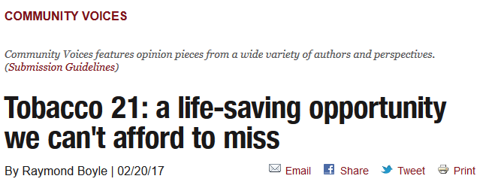
Impact of Tobacco 21 in Minnesota
30,000 fewer youth will become smokers over the next 15 years.
Source: Boyle et. al. 2017.
Notes:
Using the same model that that institute of medicine used, local researchers ( CWMN and MDH) found that we could prevent 30,000 youth from becoming smokers.
This is the same number of undergraduates at the University of Minnesota
MN data from: Boyle, R., Kingsbury, J., Parks, M., Raising the Minimum Legal Sale Age for Tobacco to 21 The Estimated Effect for Minnesota, Minnesota Medicine, Jan-Feb 2017.

Slide 39
Who supports Tobacco 21?

Slide 40
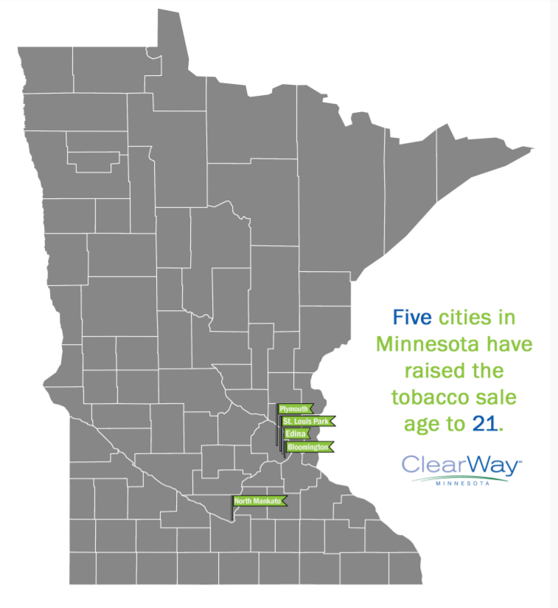

Slide 41
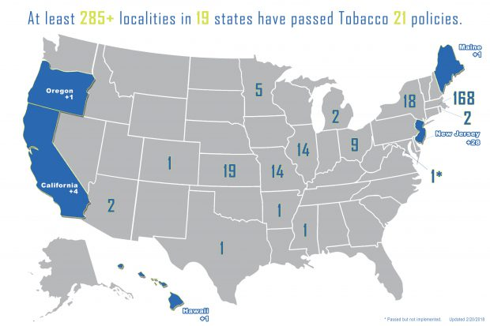
The growing list of cities and states with Tobacco 21 laws
Notes:
Momentum is growing around the U.S. around T21. Now more than 290 cities have passed T21 policies.
Edina,
St. Louis Park
Bloomington
Plymouth
North Mankato
https://www.tobaccofreekids.org/content/what_we_do/state_local_issues/sales_21/states_localities_MLSA_21.pdf

Slide 42
MN State Action
HF 3532
Introduced March 2018
Rep. Dario Anselmo (R-Edina) – Chief Author
Rep. Dave Baker (R-Willmar)
Rep. Keith Franke (R-St. Paul Park)
Rep. Mike Freiberg (DFL-Golden Valley)
Rep. Laurie Halverson (DFL-Eagan)
Rep. Mary Kunesh-Podein (DFL-New Brighton)
Rep. Sandy Layman (R-Cohasset)
Rep. Rena Moran (DFL-St. Paul)
Rep. Mark Uglem (R-Champlin)
SF 2370
Introduced May 2017
Sen. Carla Nelson (R-Rochester) Chief Author
Sen. Melisa Franzen (D- Edina)
Sen. Jeff Hayden (D- Minneapolis)
Sen. Erik Simonson (D- Duluth)

Slide 43
If someone can join the military at 18- shouldn’t they be able to buy tobacco?
Question
Response
We want a military force that is physically ready, and tobacco use impairs that readiness.
The Department of Defense and each of the armed services has a stated goal of a tobacco-free military.
There are several legal safeguards in place to protect the health and safety of our young people – e.g. the drinking age.
Source: National Academy of Medicine, Combating Tobacco in Military and Veteran Populations, 2009.
Notes:
Hawaii’s military bases opted to comply with their state law.
Military leaders have come out in support of T-21- Mission Readiness- Military Leaders for Kids- letter in support of Tobacco 21
“If someone is young enough to fight for their country, they should be free from addiction to a deadly drug.” Rear Admiral John Fuller, Navy Region Hawaii and Naval Surface Group Middle Pacific
There are broadly accepted restrictions on those under 21.

Slide 44
Won’t youth find ways to get tobacco regardless of what we do?
Question
Response
Tobacco 21 makes it more difficult for youth to get tobacco from social sources.
75% of smokers ages 15-17 get tobacco from social sources.
High school students are less likely to be around a 21-year-old than an 18-year-old.
Sources:
PATH Study, 2016
Ahmad, S 2005
Notes:
Increasing the tobacco purchase age to 21 will significantly reduce youth access to social sources of tobacco. It’s less about the 18-20-year-olds than it is about 15, 16, 17-year-olds . . . Because it will prevent those younger kids from getting it from 18-year-olds they know. Will it magically eliminate all youth smoking? No – but it’s a big help.
Bottom line- The disease and death caused by tobacco is significant and devastating
We must do our best to protect youth from a lifetime of addiction and health problems
Population Assessment of Tobacco and Health Study, “Highlighted Findings From Wave 1, of the Population Assessment of Tobacco and Health (PATH) Study,” Slide 63, presented at 2016 Society for Research on Nicotine and Tobacco Conference, Chicago, Illinois

Slide 45
Will Tobacco 21 hurt retailers?
Question
Response
18-20-year-olds make up roughly 2-4% of the tobacco market but provide tobacco to majority of underage smokers.
Retailers sell many non-addictive, non-disease causing products that could offset any losses.
The health benefit of saving kids from a lifetime of addiction and disease outweighs retailers having to adjust to a decline in sales.
Source: Winickoff et. al. 2014.
Notes:
https://tobacco21.org/wp-content/uploads/2014/10/Retail-impact-of-raising-tobacco-sales-age-to-21-years.pdf
T-21 addresses social sources where younger youth get tobacco from those who can legally buy it. This has nothing to do with compliance. Retailers should continue to be compliant whether the legal age is 18 or 21.

Slide 46
Why should e-cigarettes be included in Tobacco 21 policies?
Question
Response
E-cigarettes are considered tobacco products in federal and state law.
E-cigarettes are not proven to be better for quitting smoking than existing treatments and the FDA has not approved them as quitting aids.
With smoking rates falling, e-cigarettes are a way for the tobacco industry to keep hooking the next generation on their products.
Source: U.S. Surgeon General 2012
Vickerman et. al. 2013.
Popova & Ling. 2013.
Notes:
Minnesota Youth Tobacco Survey- we know youth are using these products at an alarmingly high rate and these policies will help us get these deadly products out of high schools and the social environment.

Slide 47
Couldn’t Tobacco 21 be used to target youth and communities of color?
Question
Response
The focus is on the seller- not the youth
PUP = Purchase / Use / Possession
National health leaders will only support Tobacco 21 policies that remove PUP penalties
Notes:
Local and national organizations working on this initiative do not support the implementation of penalties for young adults (18-20) for purchasing, using, and/or possessing tobacco. Penalties for purchase, use and possession have not been proven to reduce youth tobacco use and they divert focus from addressing irresponsible retailers and the tobacco industry which has a long history of targeting youth.
https://tobacco21.org/wp-content/uploads/2014/10/Retail-impact-of-raising-tobacco-sales-age-to-21-years.pdf

Slide 48
Won’t people just go to neighboring towns/cities?
Question
Response
Incremental change is progress
In Minnesota, the smoke-free movement was started at the local level
Many communities in Minnesota are considering Tobacco 21
Notes:
Needham, MA
https://tobacco21.org/wp-content/uploads/2014/10/Retail-impact-of-raising-tobacco-sales-age-to-21-years.pdf

Slide 49
In summary
Preventing youth from initiation is essential to creating a tobacco-free generation.
Five states and over 290 cities have raised the tobacco age – including Edina, Bloomington ,Plymouth, St. Louis Park and North Mankato
Raising the tobacco sales age is about 13-17-year-olds not 18,19 and 20 year-olds.
Tobacco 21address social sources at little cost to retailers.

Slide 50
Minnetonka High School
Amy Steiner & Josh Stephan
Assistant Principal MHS Student Affairs MHS

Slide 51

Perception vs Reality
Tobacco violations have real consequences.
School Suspension
State High School League Violation
Potential Loss of Leadership Positions
Suspension from Club or Activity
Removal from Club or Activity

Slide 52

Tobacco Policy
Smoking, chewing, use of tobacco or possession of tobacco in any form shall be considered grounds for suspension, exclusion or expulsion if engaged in by a pupil in or on school property, 24 hours a day, or away from school property while participating in a school sponsored activity and/or on school buses.
District Policy #417

Slide 53
MHS Handbook Definition
Tobacco products (pipes, cigarettes, all forms of electronic​ ​cigarettes​ ​and​ ​any​ ​accompanying​ ​cartridges and​ ​liquid nicotine,​ cigars, cigarette papers, chewing tobacco).

Slide 54
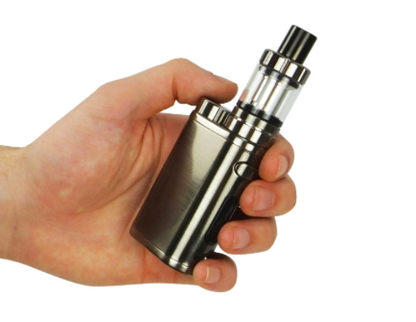
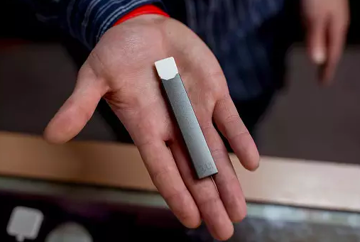
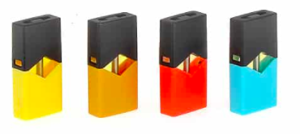

Slide 55
Violation Consequences
First offense: 1-3 Day Suspension, Referral to Law Enforcement, Activities, Chemical Health Counselor
Second Offense: 3-5 Day Suspension, Referral to Law Enforcement, Activities, Chemical Health Counselor
Third Offense: 6-10 Day Suspension, Referral to Law Enforcement, Activities, Chemical Health Counselor, Possible recommendation for Expulsion

Slide 56

Support
Parents Notified
Meeting with Administrator
Chemical Health Counselor
School Counselor

Slide 57
In Conclusion….

Slide 58
Community Resources
Relate counseling
Traverse counseling
South Lake Pediatrics
www.tonkcares.org
https://www.thetruth.com
https://www.teen.smokefree.gov/
http://www.nosmokingroom.org/

Slide 59
To Summarize….
Electronic device use is on the rise.
These devices have re-normalize smoking (especially if use is permitted in venues where traditional tobacco products have been banned).
High appeal to “non-smokers” (especially children and adolescents).
Serious health risk in neurodevelopment, future cognitive function, and increased likelihood of addiction.
95% of current adult smokers began use prior to the age of 21.
Consider policies and programs in OUR community to curb this public health concern.
Tobacco remains the leading cause of preventable death and disease in our state, moreover the Minnesota Department of Health reports 102,100 youth are projected to die from smoking related illness.
!!!!Be a part of the solution… change the conversation and the outcome!!!!

Slide 60
For More Information….
Tonka CARES
Kim Oelhafen MD, MPH
Director
952-401-5056
www.tonkacares.org
Visit us on Facebook and Twitter
Association for Nonsmokers-Minnesota
Kristen Ackert, MPH
kristen@ansrmn.org
651-646-3005
Special thank you to ANSR, Minnetonka Public Schools, and Jeff Erickson, Amy Steiner, and Josh Stephan Minnetonka High School

Slide 61
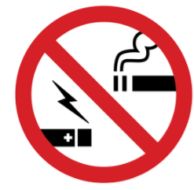
Questions ….

